Slide 2
Damath History
Damath comes from the Filipino checker board game called “dama” and mathematics
Invented in 1975 by Jesus Huenda, a teacher from Sorsogon, Philippines
It aims to make math teaching and learning student-friendly, challenging and interactive

Slide 3
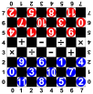
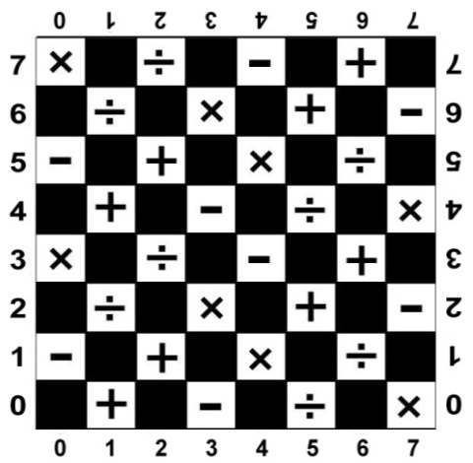
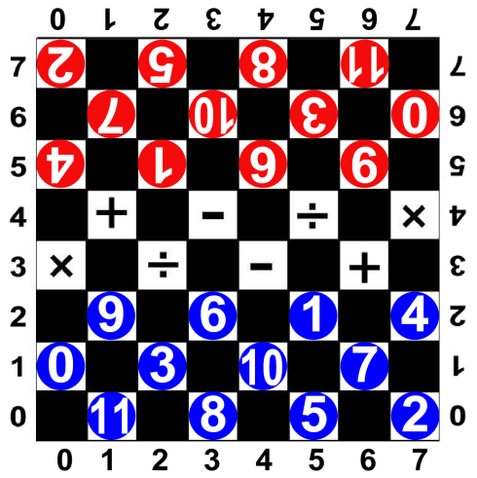
1.3 Damath - Math Checkers (Board Game)
Useful Hints
You can construct Damath by your own.
It is very important, that the teacher knows the abilities of the participants.
Start, if necessary, with easier calculations, e.g. you can mark the white fields just with + and the men with numbers between 0 and 5 – so your participants calculate e.g. just 2+3=5 or 0+5=5 or 1+2=3.

Slide 4
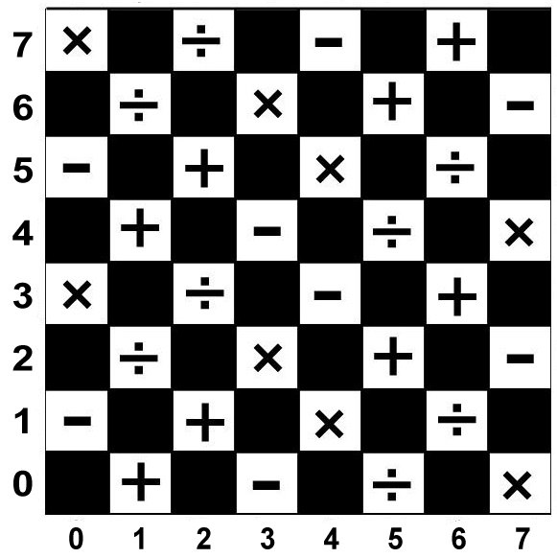
0
6.
1
7
2
8
3
9.
4
10
0
6.
5
11
1
7
2
8
3
9.
4
10
5
11

Slide 5
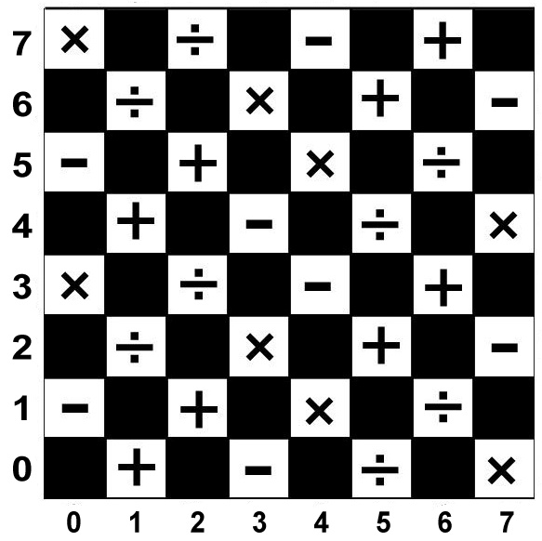
0
6.
1
7
2
8
3
9.
4
10
5
11
9.
6.
1
4
0
3
10
7
11
8
5
2

Slide 6
Start the game example:
white moves first (3,2) to (2,3), then black moves (0,5) to (1,4)
2
5
8
11
7
10
3
0
4
1
6.
9.
9.
6.
1
4
0
3
10
7
11
8
5
2

Slide 7
Now white 6 can jump over black 4 and remove it to the side
At the same time white gets 2 points, because: 6-4=2
2
5
8
11
7
10
3
0
1
6.
9.
4
Calculation white:
6-4=2
6.
9.
1
4
0
3
10
7
11
8
5
2

Slide 8
the next move could be black 6 from (4|5) to (3|4)
Now white 1 from (5|2) to (4|3)
4
2
5
8
11
7
10
3
0
6.
1
6.
9.
Calculation white:
6-4=2
9.
1
4
0
3
10
7
11
8
5
2

Slide 9
black 6 must now jump over white 1 from (3|4) to (5|2) and remove white 1
Black has to culculate: 6+1=7
4
2
5
8
11
7
10
3
0
6.
1
9.
6.
Calculation black:
6+1=7
Calculation white:
6-4=2
1
9.
4
0
3
10
7
11
8
5
2

Slide 10
Now white has to decide to jump over black 6 with white 7 or white 10 – points?
White 10 jumps over black 6 and removes it - new calculation for white?
5
1
4
2
8
11
7
10
3
0
6.
1
9.
Calculation black:
6+1=7
Calculation white:
6-4=2
10+6=16
The sum is now 18 points.
9.
6.
4
0
3
10
7
11
8
5
2

Slide 11
Basic Rules
Game duration is twenty (20) minutes
A chip is allowed to move diagonally forward only to an adjoining vacant square
A chip has to take the opponent’s chip diagonally forward to the left or to the right, thus, pass is not allowed
1 minute per move (every move is given 1 minute including the writing of moves)
Per game is given 20 minutes. After 20 minutes, remaining chips are to be added to the score

Slide 12
Score Sheet

Slide 13
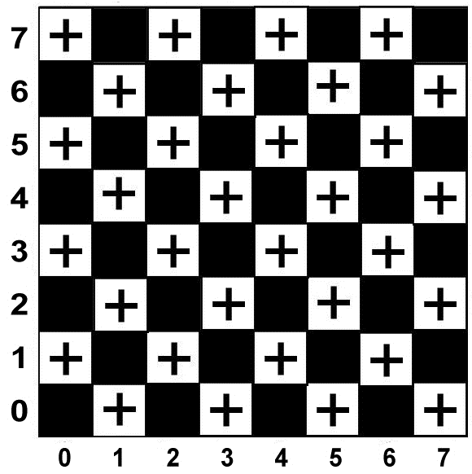
Basic form of calculation: Addition
2
5
8
11
7
10
3
0
4
1
6.
9.
9.
6.
1
4
0
3
10
7
11
8
5
2

Slide 14
1.3 Damath - Math Checkers (Board Game)
Requirements
Participants already can count and calculate with whole numbers between 0 and 11.
Students already know the rules of the game Checkers (dame)
Objectives
To exercise calculating (addition) with numbers between 0 and 11.
Be familiar with the coordinates
Students practice playing the reckoning. You have fun.

Slide 15
1.3 Damath - Math Checkers (Board Game)
Tools, Materials and Organisation
Take a checkers-board (8 by 8 fields) for each 3 players.
The white fields of the board are marked with the arithmetic symbol of addition.
Each group needs 12 white and 12 black men. These men are marked with whole numbers from 0 to 11.
Used the template from 1.2 Checkers!
The lesson takes 45 minutes.

Slide 16
1.3 Damath - Math Checkers (Board Game)
Description of the Lesson
Warm-up (5-10 minutes)
Explain the game “Damath”
Arrange groups with 3 persons (two players, one as a referee to keep time and check the calculations).
Each group is sitting on an extra table.
The role of the persons in the group: two are playing against each other.

Slide 17
1.3 Damath - Math Checkers (Board Game)
Description of the Lesson
Practice (20 minutes)
The two players toss a coin to decide who moves first
The use the score sheet to wright the coordinates of each move and the calculation if they do a capture of opponents piece
The two players alternately take turn in moving a piece
The game ends if:
The 20 minutes game period lapsed (remaining chips are to be added to the score)
The moves are repetitive
A player has no more chip to move
A player has no move to do

Slide 18
1.3 Damath - Math Checkers (Board Game)
Description of the Lesson
Evaluation – Self-evaluation (10 minutes)
Each participant is presenting his score.
The winner of the group has the most scores, but everybody has learned a lot by exercising the calculations.
Ask the students:
What I like in the game
Areas for improvement

Slide 19
1.3 Damath - Math Checkers (Board Game)
Description of the Lesson
Conclusion (5 minutes)
teacher sum-up the lesson
boosts the students’ confidence
informs them about the next lesson
teacher does a self-evaluation of the lesson (methodology and strategy)
strength and weakness of the lesson

Slide 20
1.3 Damath - Math Checkers (Board Game)
Suggestions
extend the version with the minus symbol and then other arithmetic symbols
use negative numbers
use fractions

Slide 21
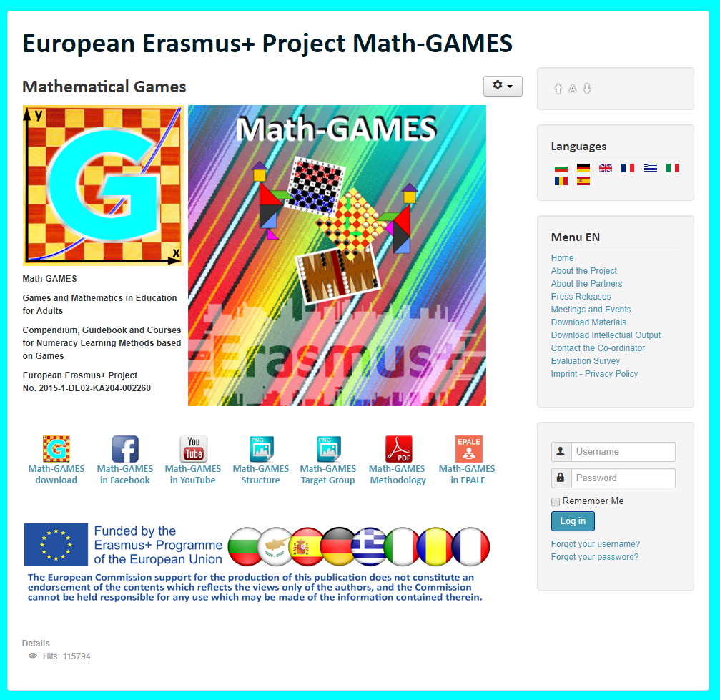
The result is: Play Games and and learn Mathematics more easily.
Our Project-Website will help you: www.math-games.eu

